Slide 1
Biweekly Meeting for RL Based Truck&Trailer Project
June 22 2023

Slide 2
Recently Updates
Finish the Pseudo code of PPO for episodic training
Halfway done the pseudo for waypoint update policy
Add Speed reward to the system and conduct testing
Craft the evaluation environment

Slide 3
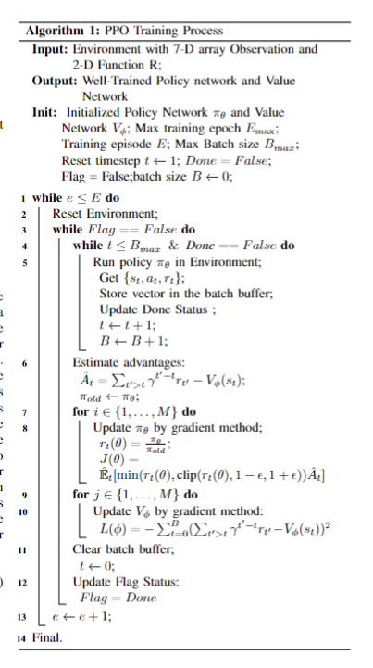




Pseudo Code for episodic PPO

Slide 4
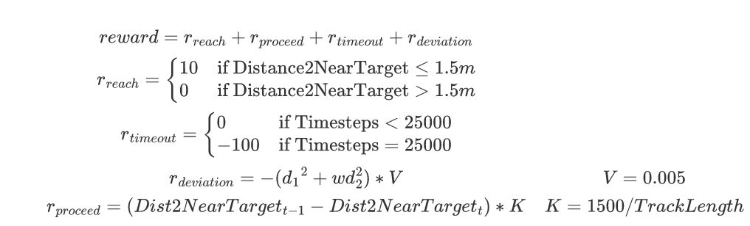

Speed Integrated of the reward

Slide 5
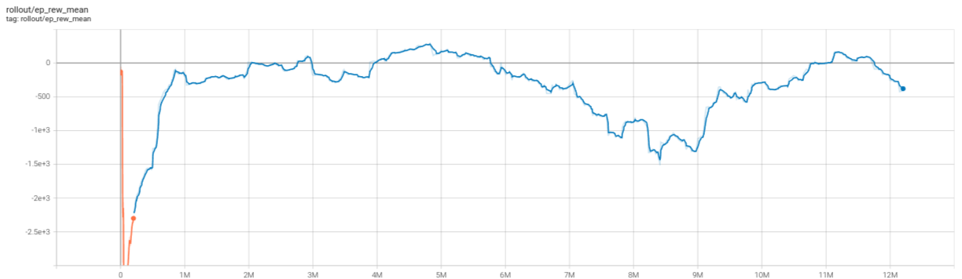
Learning curve of speed reward

Slide 6
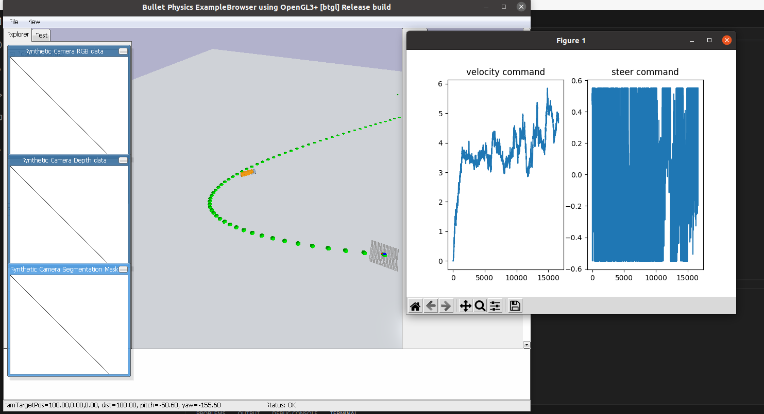

Slide 7
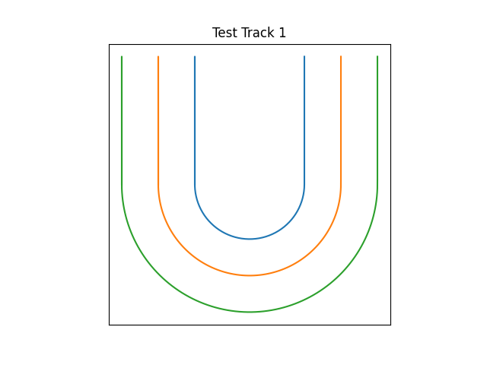
Evaluation Env1
Symbol | Meaning | Value
r1 | Turning radius of Vehicle | 12-18m
r2 | Inner side of lane | 10-15m
d1 | Vehicle width | 2.5mm
d2 | Safe distance | 0.5mm
r2 = r1 – d1-2*d2

Slide 8
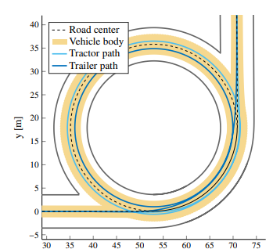
Evaluation Env2
Symbol | Meaning | Value
r1 | Turning radius of Vehicle | 12-18m
r2 | Inner side of lane | 10-15m
d1 | Vehicle width | 2.5mm
d2 | Safe distance | 0.5mm
r2 = r1 – d1-2*d2

Slide 9
Plans
Finish the pseudo code for waypoint updating
Finish the evaluation experiment and put the result into the paper
Revise the methodology part

